Slide 1
Data Structures & Algorithm
CS-102
Lecture 2

Slide 2
Linked List
Create a structure called a Node.
object
next
The object field will hold the actual list element.
The next field in the structure will hold the starting location of the next node.
Chain the nodes together to form a linked list.

Slide 3
Linked List
Picture of our list (2, 6, 7, 8, 1) stored as a linked list:
head
2
6
8
7
1
size=5
current

Slide 4
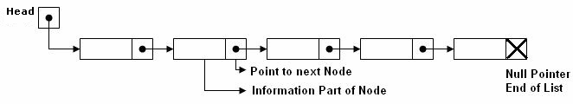
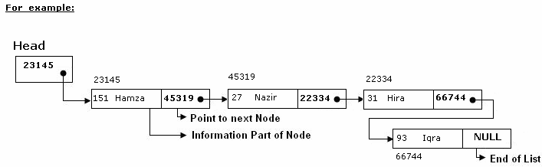
Link List

Slide 5
Linked List
Note some features of the list:
Need a head to point to the first node of the list. Otherwise we won’t know where the start of the list is.
The current here is a pointer, not an index.
The next field in the last node points to nothing. We will place the memory address NULL which is guaranteed to be inaccessible.

Slide 6
Operations on Linked List:
There are several operations associated with linked list i.e.
a) Traversing a Linked List
Suppose we want to traverse LIST in order to process each node exactly once. The traversing algorithm uses a pointer variable PTR which points to the node that is currently being processed. Accordingly, PTR->NEXT points to the next node to be processed so,

Slide 7
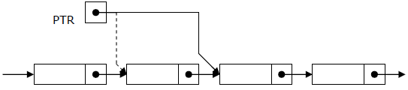
PTR:=START [ Moves the pointer to the first node of the
list]
PTR:=LINK[PTR] [ Moves the pointer to the next node in
the list.]
INFO[PTR] [Process information at the node]

Slide 8
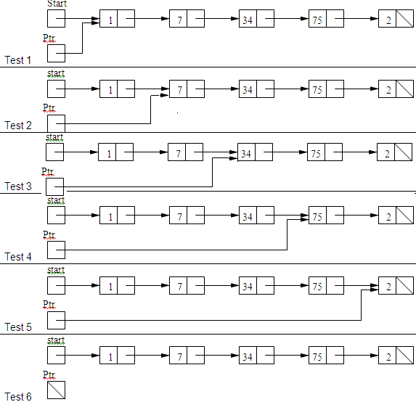

Slide 9
Algorithm: (Traversing a Linked List) Let LIST be a linked list in memory. This algorithm traverses LIST, applying an operation PROCESS to each element of list. The variable PTR point to the node currently being processed.
  1. Set PTR:=START. [Initializes pointer PTR.]
  2. Repeat Steps 3 and 4 while PTR ≠ NULL.
  3. Apply PROCESS to INFO[PTR].
  Set PTR:= LINK[PTR]. [PTR now points to the next node]
  [End of Step 2 loop.]
  5. Exit.

Slide 10
b) Searching a Linked List:(UNSORTED LIST)
Suppose the data in LIST are not necessarily sorted. Then one searches for ITEM in LIST by traversing through the list using a pointer variable PTR and comparing ITEM with the contents INFO[PTR] of each node, one by one, of LIST. Before we update the pointer PTR by PTR:=LINKPTR], we require two tests. First we have to check to see whether we have reached the end of the LIST i.e. PTR=NULL. If not, then we check to see whether INFO[PTR]=ITEM.
The two tests cannot be performed at the same time, since INFO[PTR] is not defined when PTR=NULL. Accordingly we use the First test to control the execution of a loop, and we let the second test take place inside the loop.
Algorithm: SEARCH(INFO, LINK,START, ITEM, LOC)
LIST is a linked list in the memory. This algorithm finds the location LOC of the node where ITEM first appear in LIST, or sets LOC=NULL.
1. Set PTR:=START.
2. Repeat Step 3 while PTR≠NULL:
3. If ITEM = INFO[PTR], then:
Set LOC:=PTR, and Exit. [Search is successful.]
Else:
Set PTR:=LINK[PTR]. [PTR now points to the next node]
[End of If structure.]
[End of Step 2 loop.]
4. Set LOC:=NULL. [Search is unsuccessful.]
5. Exit.

Slide 11
b) Searching a Linked List:(SORTED LIST)
Suppose the data in LIST are sorted. Again we search for ITEM in LIST by traversing the list using a pointer variable PTR and comparing ITEM with the contents INFO[PTR] of each node, one by one, of LIST. Now, however, we can stop once ITEM exceeds INFO[PTR]. (List sorted in descending order)
Algorithm: SRCHSL(INFO, LINK,START, ITEM, LOC)
LIST is sorted list in memory. This algorithm finds the location LOC of the node where ITEM first appear in LIST, or sets LOC=NULL.
1. Set PTR:=START.
2. Repeat Step 3 while PTR≠NULL:
3. If ITEM < INFO[PTR], then:
Set PTR:=LINK[PTR]. [PTR now points to the next node]
Else If ITEM=INFO[PTR],then
Set LOC:=PTR, and Exit. [Search is successful.]
Else:
LOC:=NULL , and Exit. [ITEM now exceeds INFO[PTR].]
[End of If structure.]
[End of Step 2 loop.]
4. Set LOC:=NULL.
5. Exit.

Slide 12
Search Linked List for insertion and deletion of Nodes:
Both insertion and deletion operations need searching the linked list.
To add a new node, we must identify the logical predecessor (address of previous node) where the new node is to be inserting.
To delete a node, we must identify the location (addresses) of the node to be deleted and its logical predecessor (previous node).
Basic Search Concept
Assume there is a sorted linked list and we wish that after each insertion/deletion this list should always be sorted. Given a target value, the search attempts to locate the requested node in the linked list.
Since nodes in a linked list have no names, we use two pointers, pre (for previous)and cur (for current) nodes. At the beginning of the search, the pre pointer is null and the cur pointer points to the first node (Head). The search algorithm moves the two pointers together towards the end of the list. Following Figure shows the movement of these two pointers through the list in an extreme case scenario: when the target value is larger than any value in the list.

Slide 13
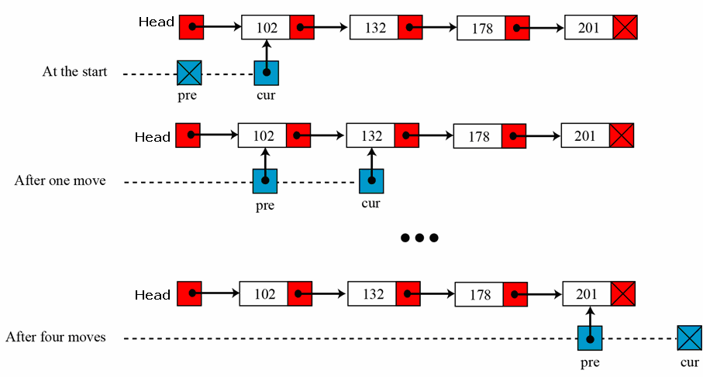
Moving of pre and cur pointers in searching a linked list

Slide 14
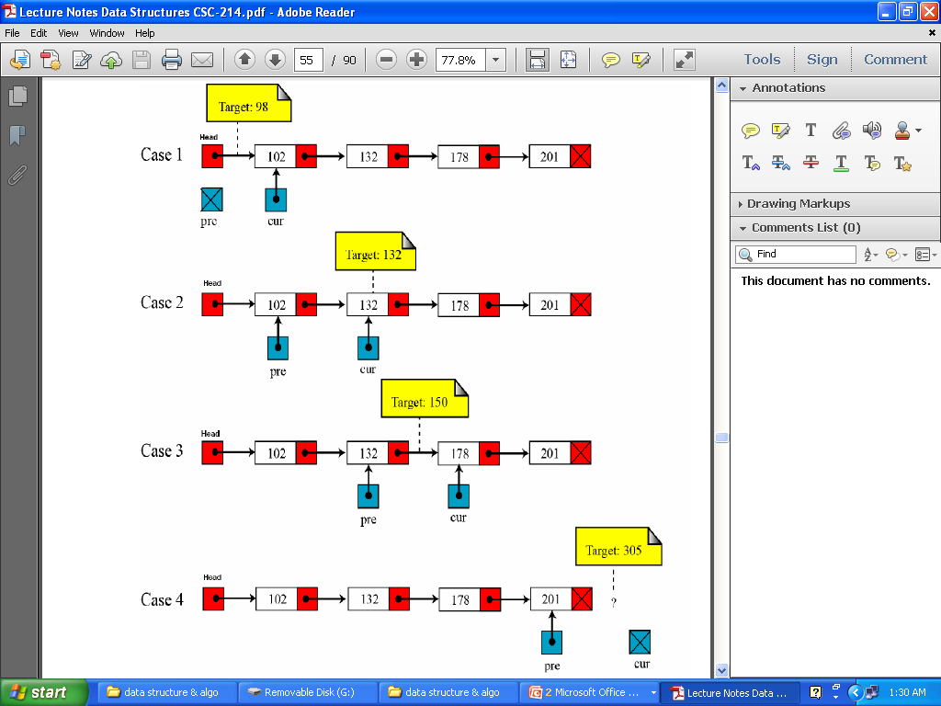
Values of pre and cur pointers in different cases

Slide 15
Linked List Operations
add(9): Create a new node in memory to hold ‘9’
Node* newNode = new Node(9);
newNode
9
Notes:
The second goal is the “nuts and bolts” of the course.
The third goal prepares a student for the future.

Slide 16
Linked List Operations
add(9): Create a new node in memory to hold ‘9’
Node* newNode = new Node(9);
Link the new node into the list
newNode
9
head
2
6
8
7
1
size=5 6
current
2
1
3
9
newNode
Notes:
The second goal is the “nuts and bolts” of the course.
The third goal prepares a student for the future.

Slide 17
C++ Code for Linked List
The Node class
class Node {
public:
int get() { return object; };
void set(int object) { this->object = object; };
Node *getNext() { return nextNode; };
void setNext(Node *nextNode)
{ this->nextNode = nextNode; };
private:
int object;
Node *nextNode;
};
Notes:
The first goal is a worldview to adopt
The second goal is the “nuts and bolts” of the course.
The third goal prepares a student for the future.

Slide 18
C++ Code for Linked List
#include <stdlib.h>
#include "Node.cpp"
class List {
public:
// Constructor
List() {
headNode = new Node();
headNode->setNext(NULL);
currentNode = NULL;
size = 0;
};
Notes:
The first goal is a worldview to adopt
The second goal is the “nuts and bolts” of the course.
The third goal prepares a student for the future.

Slide 19
C++ Code for Linked List
void add(int addObject) {
Node* newNode = new Node();
newNode->set(addObject);
if( currentNode != NULL ){
newNode->setNext(currentNode->getNext());
currentNode->setNext( newNode );
lastCurrentNode = currentNode;
currentNode = newNode;
}
else {
newNode->setNext(NULL);
headNode->setNext(newNode);
lastCurrentNode = headNode;
currentNode = newNode;
}
size++;
};
Notes:
The first goal is a worldview to adopt
The second goal is the “nuts and bolts” of the course.
The third goal prepares a student for the future.

Slide 20
Building a Linked List
List list;
headNode
size=0
Notes:
The first goal is a worldview to adopt
The second goal is the “nuts and bolts” of the course.
The third goal prepares a student for the future.

Slide 21
Building a Linked List
List list;
headNode
size=0
currentNode
list.add(2);
headNode
2
size=1
lastcurrentNode
Notes:
The first goal is a worldview to adopt
The second goal is the “nuts and bolts” of the course.
The third goal prepares a student for the future.

Slide 22
Building a Linked List
List list;
headNode
size=0
currentNode
list.add(2);
headNode
2
size=1
lastcurrentNode
currentNode
list.add(6);
headNode
2
6
size=2
lastcurrentNode
Notes:
The first goal is a worldview to adopt
The second goal is the “nuts and bolts” of the course.
The third goal prepares a student for the future.

Slide 23
Building a Linked List
List.add(8); list.add(7); list.add(1);
currentNode
headNode
2
6
8
7
1
size=5
lastcurrentNode
Notes:
The first goal is a worldview to adopt
The second goal is the “nuts and bolts” of the course.
The third goal prepares a student for the future.

Slide 24
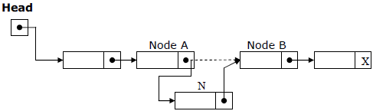
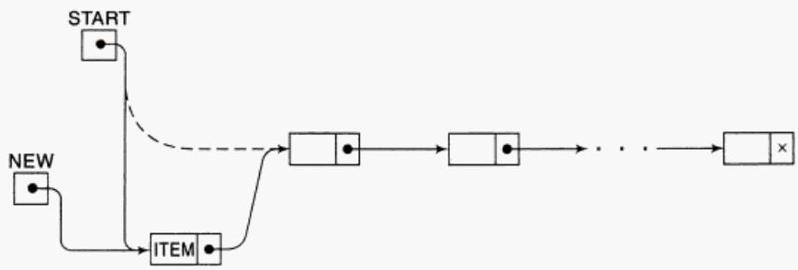
Insertion at the beginning of a List
Insertion into a Linked List:
If a node N is to be inserted into the list between nodes A and B in a linked list named LIST. Its schematic diagram would be:

Slide 25
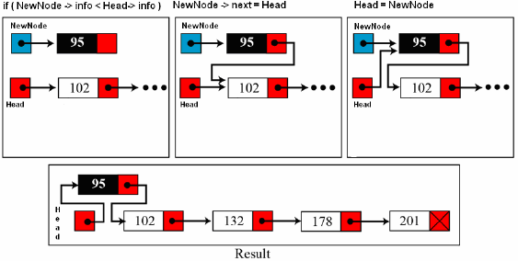
Inserting at the Beginning of a List:
If the linked list is sorted list and new node has the least low value already stored in the list i.e. (if New->info < Head->info) then new node is inserted at the beginning / Top of the list.

Slide 26
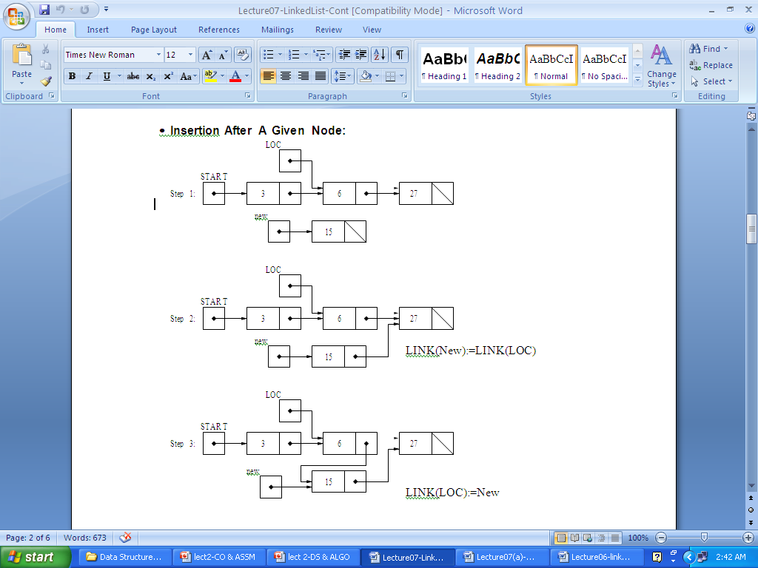

Slide 27
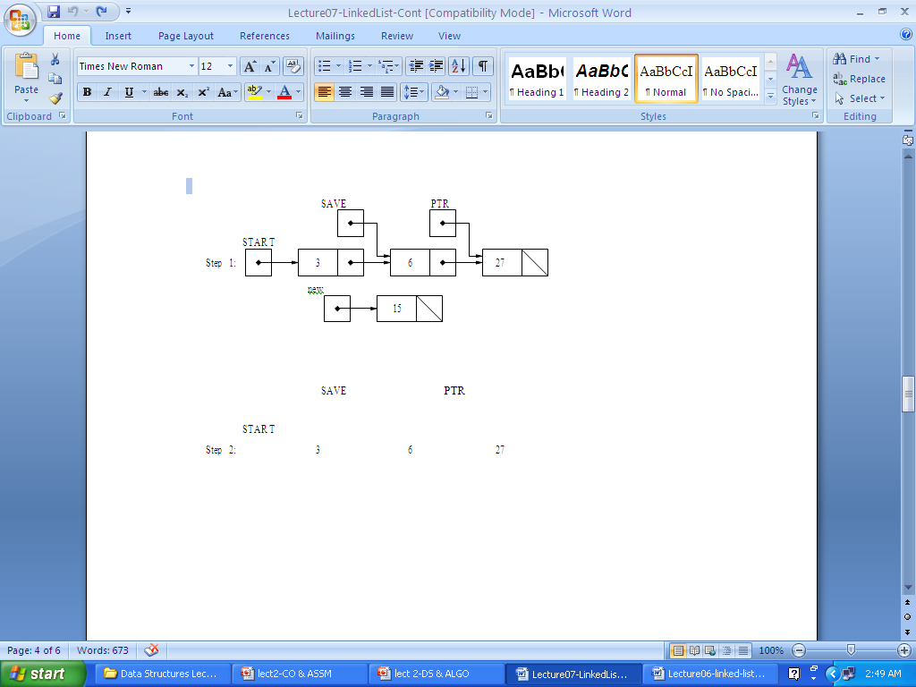
Insertion In Sorted Linked List
Steps:
Find the Location of the node after witch new node will be inserted
Use Insertion method to insert into the Linked List
Find the Location of the node
Search the Item after which insertion needs to be made . As the Linked List is sorted searching will result in the location of element >given ITEM
As Insertion can not be made before a Node therefore another pointer will keep track of the previous node i.e before moving the PTR , Save := PTR
Thus PTR points to current node Element which is > ITEM while SAVE points to Element<ITEM
Thus Insertion can be made after SAVE

Slide 28
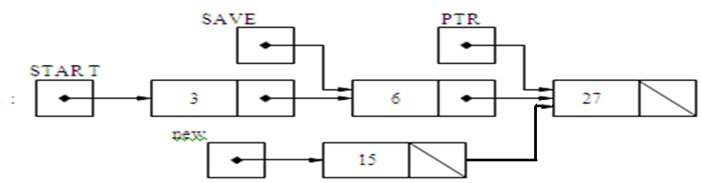
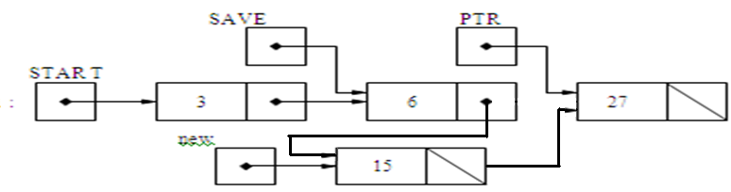
2
3

Slide 29
C++ Code for Linked List
int get() {
if (currentNode != NULL)
return currentNode->get();
};
Notes:
The first goal is a worldview to adopt
The second goal is the “nuts and bolts” of the course.
The third goal prepares a student for the future.

Slide 30
C++ Code for Linked List
bool next() {
if (currentNode == NULL) return false;
lastCurrentNode = currentNode;
currentNode = currentNode->getNext();
if (currentNode == NULL || size == 0)
return false;
else
return true;
};
Notes:
End of lecture 3
The second goal is the “nuts and bolts” of the course.
The third goal prepares a student for the future.

Slide 31
Deletion from a Link List
C++ Code for Linked List
void remove() {
if( currentNode != NULL &&
currentNode != headNode) {
lastCurrentNode->setNext(currentNode->getNext());
delete currentNode;
currentNode = lastCurrentNode->getNext();
size--;
}
};
currentNode
headNode
2
6
8
7
1
size=5
lastcurrentNode
Notes:
The first goal is a worldview to adopt
The second goal is the “nuts and bolts” of the course.
The third goal prepares a student for the future.

Slide 32
C++ Code for Linked List
void remove() {
if( currentNode != NULL &&
currentNode != headNode) {
lastCurrentNode->setNext(currentNode->getNext());
delete currentNode;
currentNode = lastCurrentNode->getNext();
size--;
}
};
1
currentNode
headNode
1
2
6
8
7
1
size=5
lastcurrentNode
Notes:
The first goal is a worldview to adopt
The second goal is the “nuts and bolts” of the course.
The third goal prepares a student for the future.

Slide 33
C++ Code for Linked List
void remove() {
if( currentNode != NULL &&
currentNode != headNode) {
lastCurrentNode->setNext(currentNode->getNext());
delete currentNode;
currentNode = lastCurrentNode->getNext();
size--;
}
};
1
2
currentNode
headNode
1
2
8
7
1
size=5
2
lastcurrentNode
Notes:
The first goal is a worldview to adopt
The second goal is the “nuts and bolts” of the course.
The third goal prepares a student for the future.

Slide 34
C++ Code for Linked List
void remove() {
if( currentNode != NULL &&
currentNode != headNode) {
lastCurrentNode->setNext(currentNode->getNext());
delete currentNode;
currentNode = lastCurrentNode->getNext();
size--;
}
};
1
2
3
4
3
currentNode
headNode
1
4
2
8
7
1
size=4
2
lastcurrentNode
Notes:
The first goal is a worldview to adopt
The second goal is the “nuts and bolts” of the course.
The third goal prepares a student for the future.

Slide 35
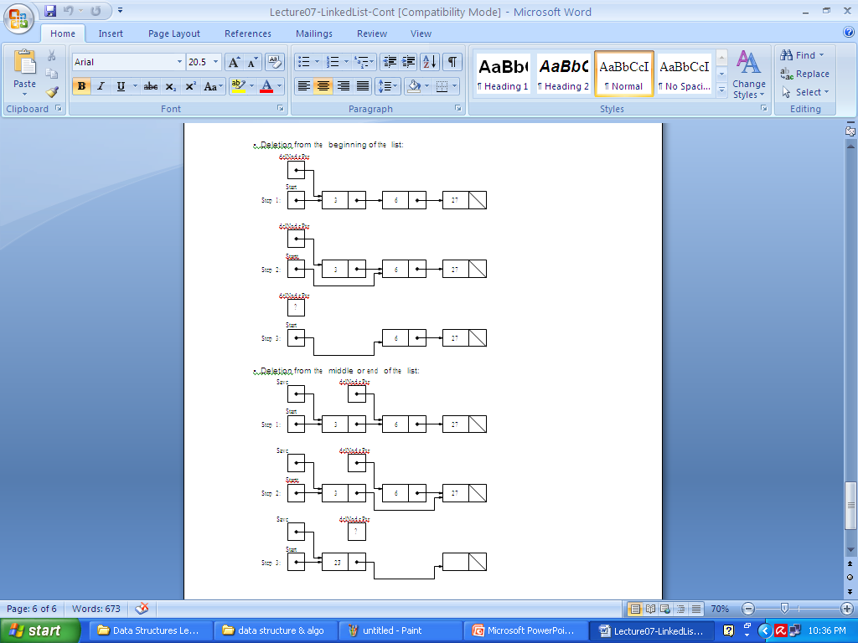

Slide 36
C++ Code for Linked List
int length()
{
return size;
};
private:
int size;
Node *headNode;
Node *currentNode, *lastCurrentNode;
Notes:
The first goal is a worldview to adopt
The second goal is the “nuts and bolts” of the course.
The third goal prepares a student for the future.

Slide 37
Example of List Usage
#include <iostream>
#include <stdlib.h>
#include "List.cpp"
int main(int argc, char *argv[])
{
List list;
list.add(5); list.add(13); list.add(4);
list.add(8); list.add(24); list.add(48); list.add(12);
list.start();
while (list.next())
cout << "List Element: "<< list.get()<<endl;
}
Notes:
The first goal is a worldview to adopt
The second goal is the “nuts and bolts” of the course.
The third goal prepares a student for the future.

Slide 38
Analysis of Linked List
add
  we simply insert the new node after the current node. So add is a one-step operation.
remove
  remove is also a one-step operation
find
  worst-case: may have to search the entire list
back
  moving the current pointer back one node requires traversing the list from the start until the node whose next pointer points to current node.
Notes:
The first goal is a worldview to adopt
The second goal is the “nuts and bolts” of the course.
The third goal prepares a student for the future.

Slide 39
Two-Way or Doubly-linked List
Moving forward in a singly-linked list is easy; moving backwards is not so easy.
To move back one node, we have to start at the head of the singly-linked list and move forward until the node before the current.
To avoid this we can use two pointers in a node: one to point to next node and another to point to the previous node:
prev
element
next
Notes:
The first goal is a worldview to adopt
The second goal is the “nuts and bolts” of the course.
The third goal prepares a student for the future.

Slide 40
Doubly-Linked List Node
class Node {
public:
int get() { return object; };
void set(int object) { this->object = object; };
Node* getNext() { return nextNode; };
void setNext(Node* nextNode)
{ this->nextNode = nextNode; };
Node* getPrev() { return prevNode; };
void setPrev(Node* prevNode)
{ this->prevNode = prevNode; };
private:
int object;
Node* nextNode;
Node* prevNode;
};

Slide 41
Doubly-linked List
Need to be more careful when adding or removing a node.
Consider add: the order in which pointers are reorganized is important:
head
2
6
8
7
1
size=5
current
Notes:
The first goal is a worldview to adopt
The second goal is the “nuts and bolts” of the course.
The third goal prepares a student for the future.

Slide 42
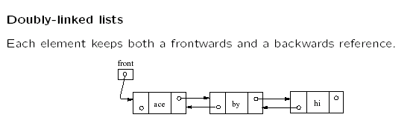

Slide 43
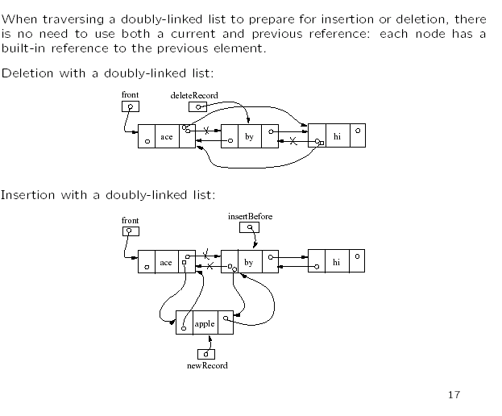

Slide 44
Insertion in Doubly-linked List
newNode->setNext( current->getNext() );
current
head
2
6
8
7
1
size=5
newNode
9
1
Notes:
The first goal is a worldview to adopt
The second goal is the “nuts and bolts” of the course.
The third goal prepares a student for the future.

Slide 45
Doubly-linked List
newNode->setNext( current->getNext() );
newNode->setprev( current );
current
head
2
6
8
7
1
size=5
2
newNode
9
1
Notes:
The first goal is a worldview to adopt
The second goal is the “nuts and bolts” of the course.
The third goal prepares a student for the future.

Slide 46
Doubly-linked List
newNode->setNext( current->getNext() );
newNode->setprev( current );
(current->getNext())->setPrev(newNode);
current
head
2
6
8
7
1
size=5
2
3
newNode
9
1
Notes:
The first goal is a worldview to adopt
The second goal is the “nuts and bolts” of the course.
The third goal prepares a student for the future.

Slide 47
Doubly-linked List
newNode->setNext( current->getNext() );
newNode->setprev( current );
(current->getNext())->setPrev(newNode);
current->setNext( newNode );
current
head
2
6
8
7
1
size=5
2
4
3
newNode
9
1
Notes:
The first goal is a worldview to adopt
The second goal is the “nuts and bolts” of the course.
The third goal prepares a student for the future.

Slide 48
Doubly-linked List
newNode->setNext( current->getNext() );
newNode->setprev( current );
(current->getNext())->setPrev(newNode);
current->setNext( newNode );
current = newNode;
size++;
head
2
6
8
7
1
size=6
2
4
3
newNode
9
1
current
Notes:
The first goal is a worldview to adopt
The second goal is the “nuts and bolts” of the course.
The third goal prepares a student for the future.

